Slide 1
Virtual Learning System Management
Presented by: Aayush Raj
Mentored by: Subbu

Slide 2
Project Overview
Objective:
Develop an online learning platform with an admin-focused module.
Key Features:
Learners and Admin management
Course creation and management
System monitoring and reporting
Technologies Used:
Angular
Spring Boot
MySQL
Postman

Slide 3

Technology Stack
Frontend: Angular
Responsive design and dynamic user interface.
Backend: Spring Boot
RESTful API development.
Database: MySQL
Secure and structured data storage.
Postman:
API testing and documentation.

Slide 4
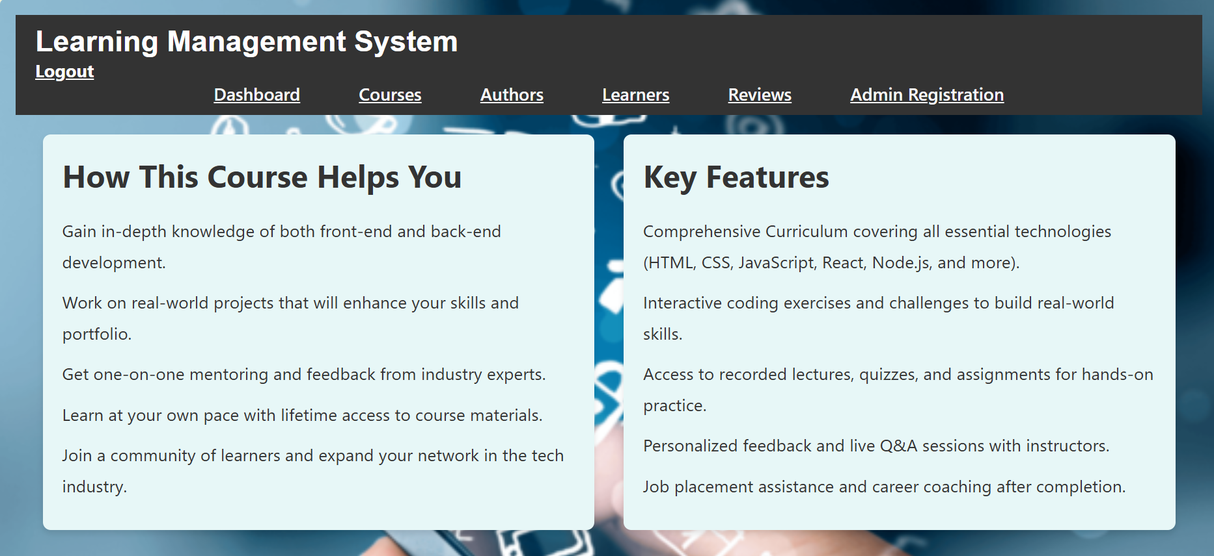
Admin Functionalities:
User account creation and management.
Course creation and updates.
Monitoring system activities.
Generating learners detailed reports.

Slide 5
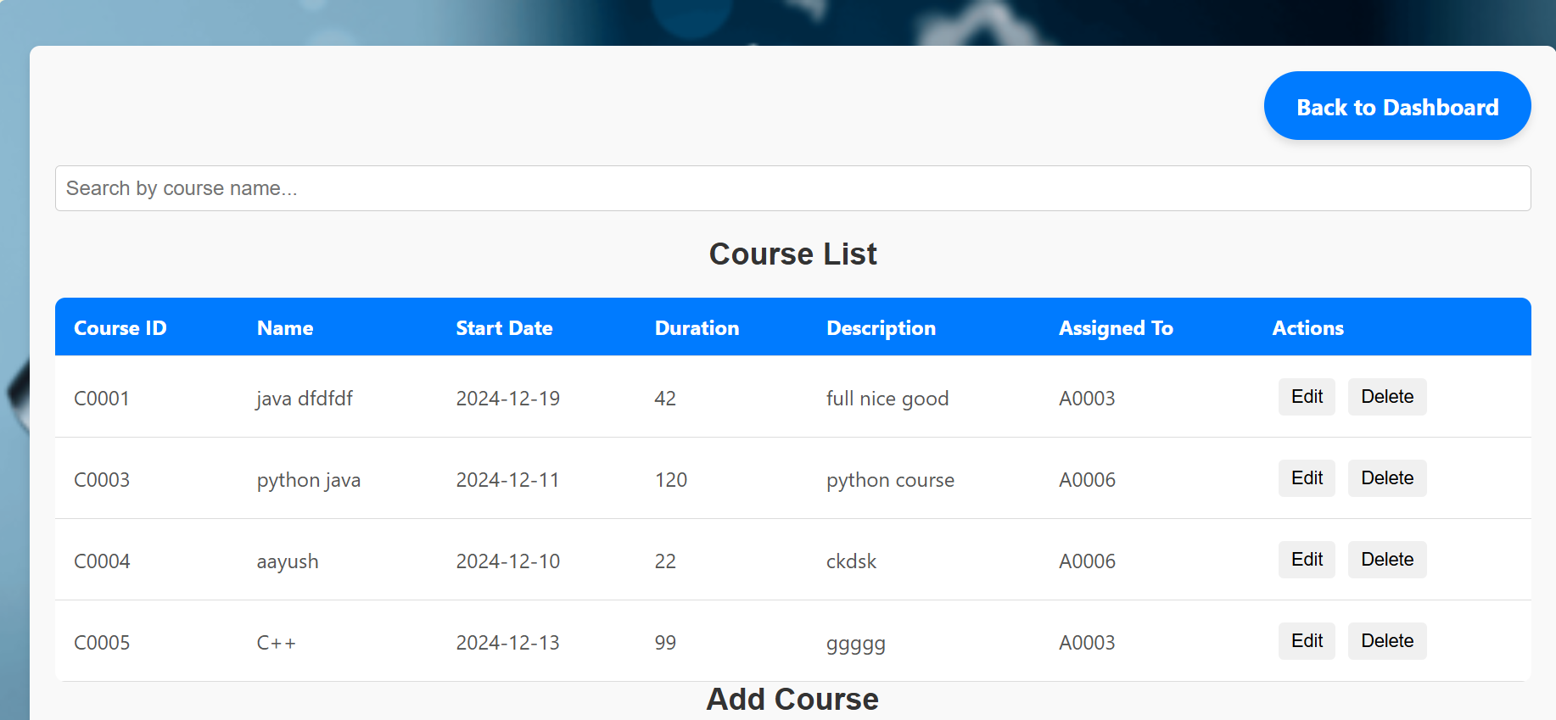

Slide 6
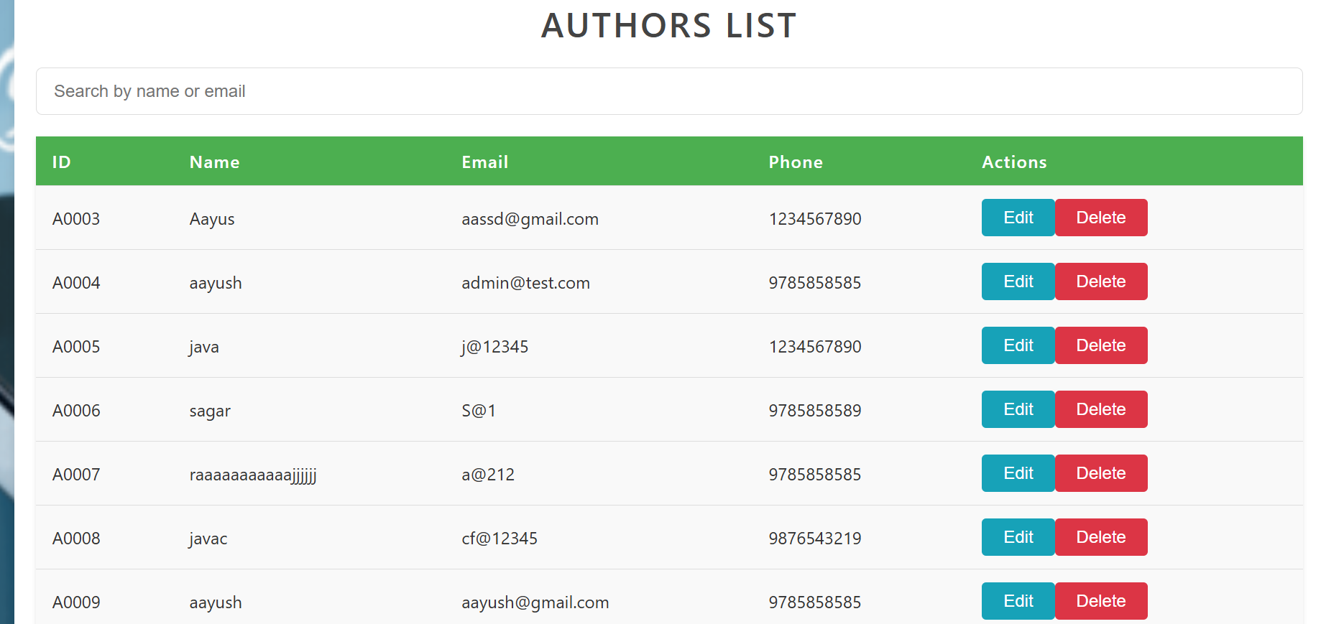

Slide 7
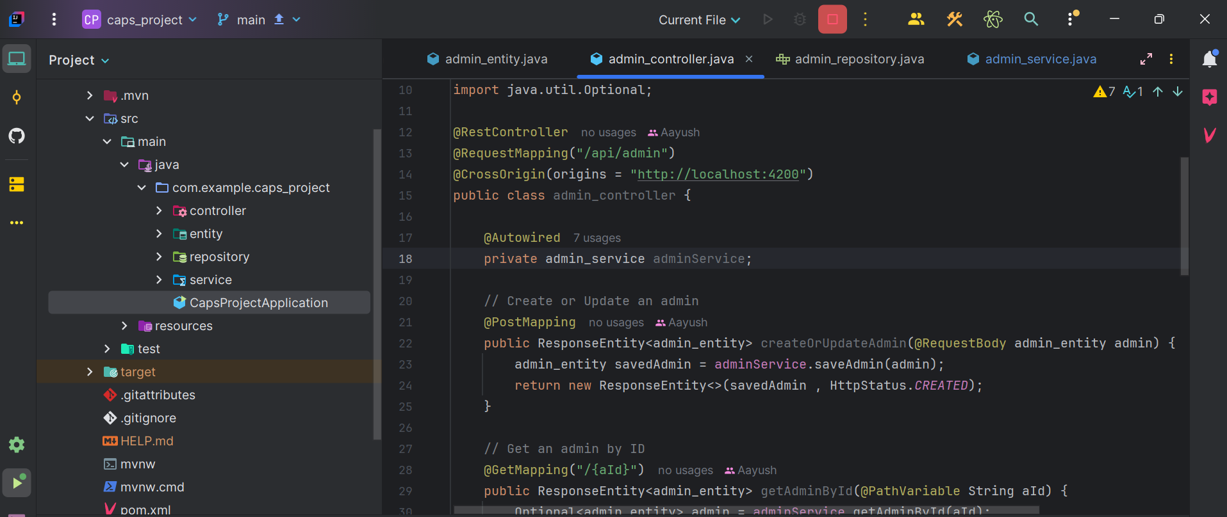
API Development and Testing
RESTful APIs:
Built using Spring Boot for admin functionalities.
API Testing:
Validated endpoints using Postman.
Ensured reliability and performance.

Slide 8
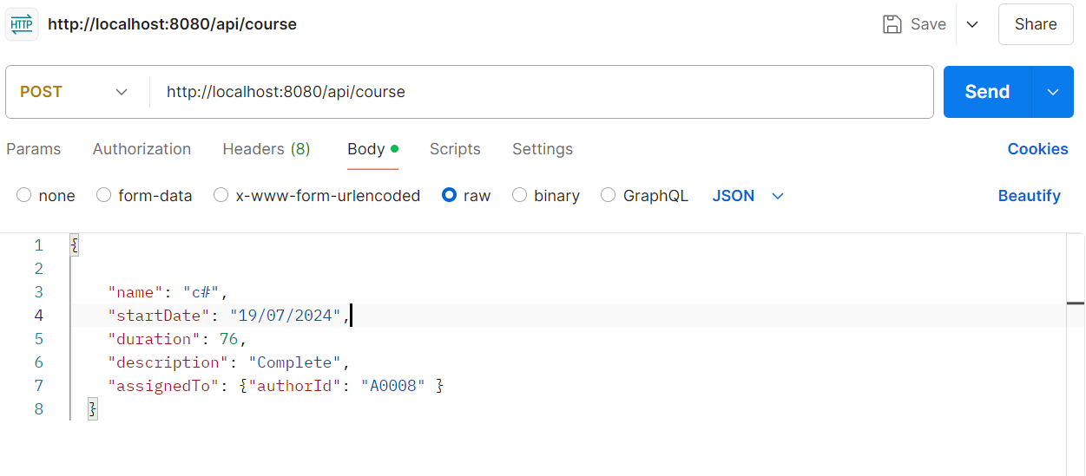
Testing:
Functional and API testing with Postman.

Slide 9
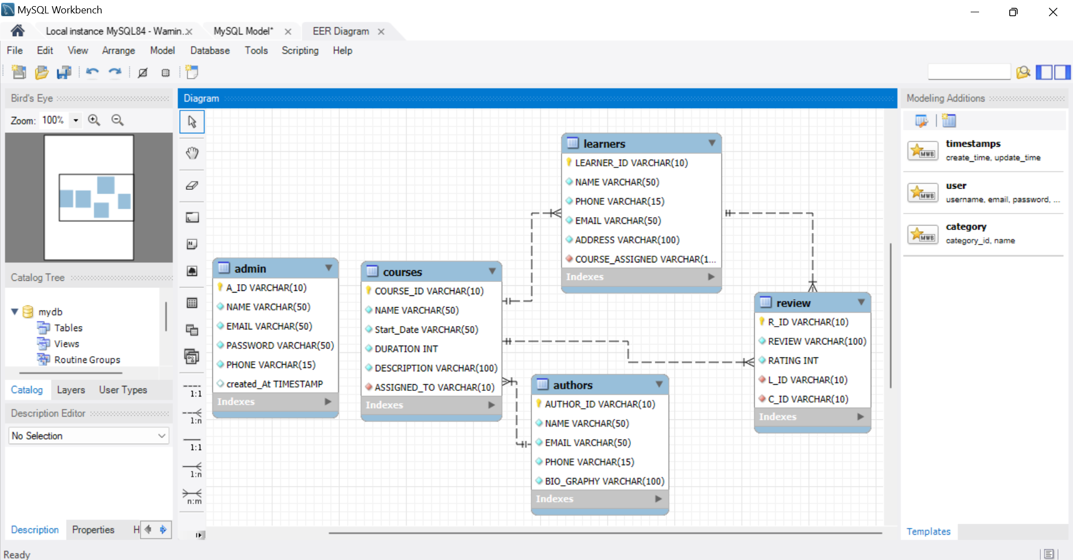
Database Design
MySQL Database:
Tables for users, courses, learners and review.
Key Constraints:
Primary key ,Foreign key, Unique and not null, On delete and On update Cascade.

Slide 10
Challenges and Solutions
Challenges:
Handling data consistency during updates.
Ensuring secure admin operations.
API performance optimization.
Solutions:
Implemented Crud operations.
Used secure authentication protocols.
Optimized backend logic.

Slide 11
Challenges:
Auto ID Generation: Ensuring unique ID generation in a valid format.
Primary-key : relation and connection.
Timestamp Error: Addressing issues with incorrect or inconsistent timestamps.
ID Reset Issue: Preventing the auto-generated ID from resetting to the initial value (e.g., "A0001") upon restarting the backend.
Layout Problems: Resolving various design and layout inconsistencies across pages.
Page Navigation: Properly linking each page to another using appropriate service integrations.

Slide 12
Results and Benefits
Outcomes:
Streamlined admin operations.
Efficient course and user management.
Real-time system insights and reporting.
A robust admin-focused platform integrating Angular, Spring Boot, MySQL, and Postman.
Benefits:
Centralized control for administrators.
Improved decision-making with detailed reports.

Slide 13

Thank you

